Slide 1
THEMES

Slide 2
Quality
The purpose of the knowledge in the Quality Theme is to define and implement a system that will create and verify that products are fit for use. So the Quality Theme defines the PRINCE2 approach to ensure that products created during the project meet the expectations, and that the end-product can be used as intended.
If the quality of the products is not as expected, then the expected benefits that should be realized as a result of the project will not be achieved. The products must work as expected for the project to deliver the expected benefits.
Product focus is one of the principles of PRINCE2, which means that a project’s products should be clearly defined at the start of the project. This includes the Quality criteria information, so that all project stakeholders have a common understanding of the products that will be created.

Slide 3
Quality
In PRINCE2, quality focuses on ensuring that the project’s products are fit for purpose. The approach, defined in the project’s Quality Management Strategy, requires that there be an explicit understanding of project scope and the quality criteria against which the products will be assessed.
There are three key aspects to quality within the project:
Quality Assurance
Quality Planning
Quality Control

Slide 4
Quality Assurance
Quality Assurance This must be independent of the project management team
It ensures that the project’s direction and management remains aligned with relevant corporate or programme management standards and policies.
Quality assurance therefore, is all about independently checking that the organization and processes are in place for quality planning and control.

Slide 5
Project Assurance vs Quality Assurance
Project Assurance | Quality assurance
Responsibility of the project board Internal to the project Must be independent of the project manager, project support, team managers and project teams May be delegated | Responsibility of corporate management External to the project Ensures compliance with relevant corporate/programme management and policies Performed by personnel who are independent of the project

Slide 6
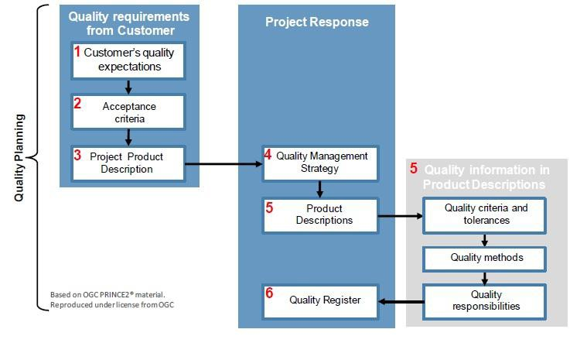
Quality Planning
Quality planning is needed for control and covers definition of the products within the project along with their quality criteria, quality methods and quality responsibilities.

Slide 7
Project product description
The Project Product Description is a special form of product description that defines what the project must deliver in order to gain acceptance. It is used to:
Gain agreement from the user on the project’s scope and reqirements
Define the customer’s quality expectations
Define the acceptance criteria, method and responsibilities for the project
It is used by the closing a project process as part of the verification that the project has delivered what was expected of it, and that the acceptance criteria have been met.

Slide 8
Product description
The Product Description is used to:
Understand the detailed nature, purpose, function and appearence of the product
Define who will use the product
Identify the sources of information or supply for the product
Identify the level of quality required of the product
Enable identification of activities to produce, review and approve the product
Define the people or skills required to produce, review and approve the product

Slide 9
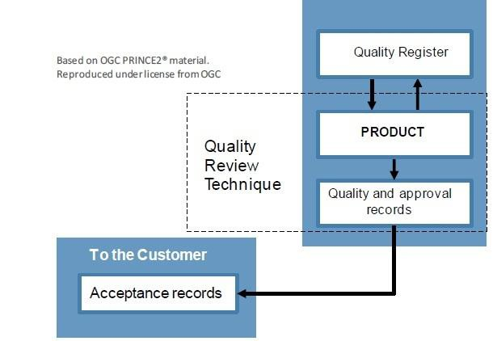
Quality Control
Quality control is reactive, and covers techniques and activities as
- Quality inspections or testing
- Finding ways of eliminating causes of and satisfactory performance.
This is where the application of lessons learned can be helpful.

Slide 10
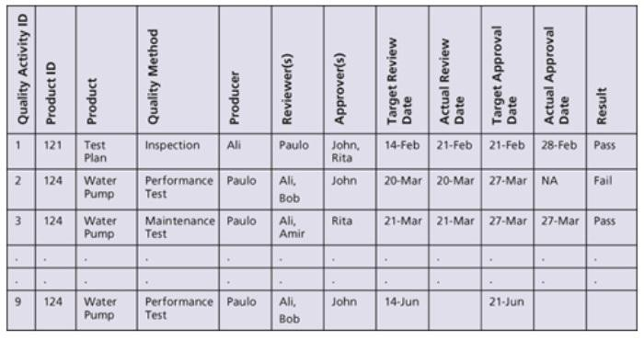
Quality Control
The Quality Register is a diary of the Quality events that take place during the project, such as workshops, reviews, testing and acceptance.
At first, the Quality Register will be empty and the Project Manager can start to add the data towards the end of Quality Planning. Most Project Managers will use a spreadsheet for a Quality Register.

Slide 11
Quality Methods
In-Process method allows you to detect flaws earlier, as
The products are tested while they are being developed. Examples include unit testing in software, integration testing, checklists and inspections. In the new laptop project, integration tests will be done to make sure the different products work together.
Appraisal Method: This involves testing the finished product and will depend on the type of product you are creating. In the new laptop project, some tests can be done on the finished product, which could include a full software diagnostic, shaking the device, and so on.
Now let us look at the Elevator product:
  The Technician who installs the elevator could do an In-Process test to check different parts of the elevator as it is being installed.
  The Safety persons will use the Appraisal Method, as they will look at the finished product.

Slide 12
Quality Records
Quality Records provide evidence that each product has met its requirements as specified in its Product Description. These records support the entries made in the Quality Register, as the Quality Register just provides a very high- level overview of the activities. For example, these Quality Records provide evidence or proof of (1) who approved what, (2) the reports and audits that have taken place and (3) audit reports to show that products have met specific Quality criteria.

Slide 13
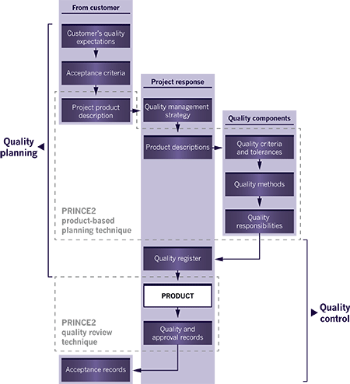
Application of quality theme

Slide 14
Quality
Quality Review Technique
The PRINCE2 quality review technique is used to assess a product against set quality criteria, and works well for a document walkthrough or analysis of test results.
The quality review technique confirms that the product is complete, ready for approval and that it can be baselined and placed under change control.
The quality review technique consist of the following three steps
Prepare for Quality Review
Conduct the Quality Review
Perform Quality Review
Follow - up

Slide 15
Quality Roles & Responsibilites
Corporate or Program Management
Provide details of the Corporate or Program Quality Management System. (They inform the project about the existing Quality systems in place.)
Provide Quality Assurance to the project.
Executive
They can also approve the Project Product Description & Quality Management Strategy with the Senior User.
Senior Supplier
Provide resources to undertake supplier Quality activities.
Senior User
Provide the companies’ Quality Expectations and Acceptance Criteria for the Project Product. This makes sense, as the Senior User is also responsible for the product specifications.
Approve the Project Product Description and Quality Management Strategy. This could also be done by the Executive.
They can also approve the Product Descriptions for key products. Provide acceptance of the Project Product.

Slide 16
Quality
Project Manager
Document the customer’s Quality Expectations and Acceptance Criteria. They will work with the Senior User on this.
Prepare the Project Product Description with other persons involved in the project. Prepare the Quality Management Strategy document, which defines how Quality will be done in the project.
Ensure that the Team Managers implement the Quality Control measures agreed in the Product Descriptions and Work Packages.
Team Manager
Produce products consistent with Product Descriptions.
Advise the Project Manager of the product Quality status.
Project Assurance
Advise the Project Manager on the Quality Management Strategy and on suitable
reviewers and approvers.
Assure the Project Board members on the implementation of the Quality Management System.
Project Support
Provide administrator support for Quality Control.
Maintain Quality Register and the Quality Records.

Slide 17
Plan
The purpose of the Plans theme is to provide the following information to all the project team members and thereby facilitate effective communication and control.
What is required
How it will be achieved and by whom and details on any specific resource such as specialized hardware or equipment required
Details on activities and milestones
The targets for time, cost, quality, scope, risk and benefits
Provides a baseline against which progress can be measured.

Slide 18
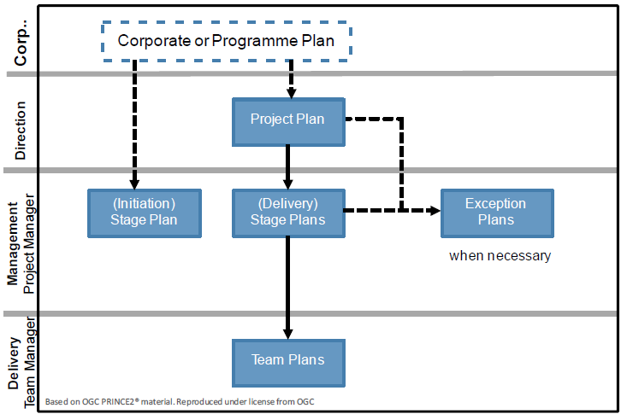
Plan
PRINCE2 recommends three levels of plan
Project Stage
Team plans (Optional)
The first plan to be created in PRINCE2 is an initiation stage plan; this plan is created in starting up a project process.

Slide 19
Plan
PRINCE2 uses the principle of management by exception. Whenever a plan is forecast to exceed the allowed tolerance, then an exception report must be created , the purpose is to effectively utilize the managements time.
If required, an exception plan will now be prepared for the appropriate management level to show the actions required to recover from the effects of a tolerance deviation. If an exception plan is approved it will replace the original hence become the new baselined plan (for the project or stage level).

Slide 20
Plan
An exception plan at project level must be referred by the project board up to corporate or programme management as they alone have the authority to approve such a plan.
If the exception plan is to replace the stage plan, then the project board has the authority to approve it.
If the project manager has set tolerances at work package level, and the team manager is now forecasting that such tolerances will be exceeded, then an issue is raised to bring this to the attention of the project manager, who will determine if this issue can be resolved within stage tolerance levels. If corrective action is needed and approved by the project manager, then this may result by an update to the current work package or authorizing a new work package.

Slide 21
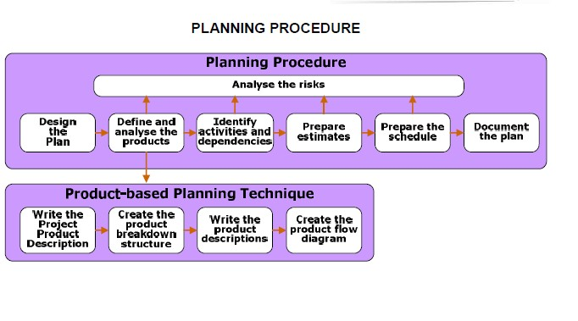
Plan

Slide 22
Plan
Identify Activities and Dependencies
It involves
- Define activities required to create the products of the project
- Dependencies between the activities and their relationship. The relationship can be (FS - Finish-to-Start), (SS – Start –to – Start), (FF- Finish –to – Finish) and (SF-Start –to –Finish)
- Dependencies between each activity and appropriate products must now be identified and these will include both internal and external dependencies.

Slide 23
Plan
Prepare Estimates
How long task will take, how much will cost, what effort and resources are requires
Assess and Assign Resources
The first step here is to identify who is available in terms of knowledge skills and experience, to carry out the work. This will also include the identification of available non human resources such as facilities.
The next steps is to assign such resources to each appropriate activity, taking into consideration work effort estimates and that their availability. As a consequence of this the critical path may be modified.
Resource Leveling
There are two situations which may now be present; the first is that large resource peaks will be evident at certain points within the project, and this can result in management or logistical problems. The second may result in over utilization of some resources. The act of resolving either of the above is called leveling. The critical chain technique may also be helpful at this step.

Slide 24
Plan
Prepare The Schedule
This is the generation of a bar chart or Gantt chart showing the activities, then dependencies, and the sequence in which they must be performed. Critical path analysis is normally used here, and hence the identification of critical and non-critical activities to determine the earliest project finish date along with the critical path and the client or slack of non-critical activities.
Note that the critical path by definition as zero float or slack, whereas non-critical activities will have some amount that determines the amount of time that such an activity can slip or extend without affecting future activities or the end date of the project

Slide 25
Plan
Analyze The Risks
This activity will run in parallel with all the other steps as risks may be identified at any point during the creation or update of a given plan.
The main purpose here is having identified risks, their responses and associated resources are built into the plan so that the risks can be managed.
By the very act of planning new risks may consist of those related to the plan itself or the information contained within it.
Document the plan
This is the final step and leads to the creation of the complete plan document. Aspects that need to be included here will include the schedule, the costs, the required controls and supporting text which will be added here to explain the plan, any constraints on it, external dependencies and assumptions, monitoring and can trolling activities along with risk responses.

Slide 26
Plan Management Product
It contains:
Plan Description
Plan Prerequisite
External Dependencies
Planning Assumptions
Lessons Incorporated
Monitoring & Control
Budgets
Tolerances
Product Description

Slide 27
Plan – Product Based Planning Technique
Write the Project Product Description
Create the product breakdown structure
Write the product description
Create the product flow diagram

Slide 28
Plan – Product Based Planning Technique
Write Product Project Description
This is the first step, and although the senior user is responsible for specifying the project product, it will often be created by the project manager in close communication with both the senior user and the executive of the project board.
The project product description describes the purpose of the project product and who will use it. It also contains the specialist skills required along with the customer quality expectations and the acceptance criteria, tolerances, acceptance method and exception responsibilities.

Slide 29
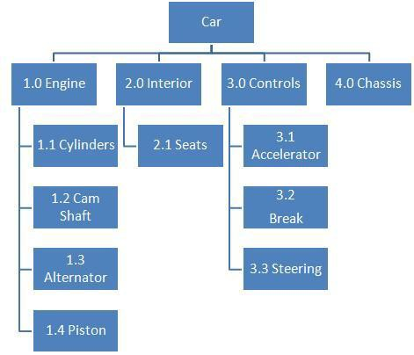
Plan – Product Based Planning Technique
Create Product Breakdown Structure

Slide 30
Plan – Product Based Planning Technique
Each product description must include the following information
Description of the product Quality Criteria
Quality Method Tolerances Producer Approver Reviewer

Slide 31
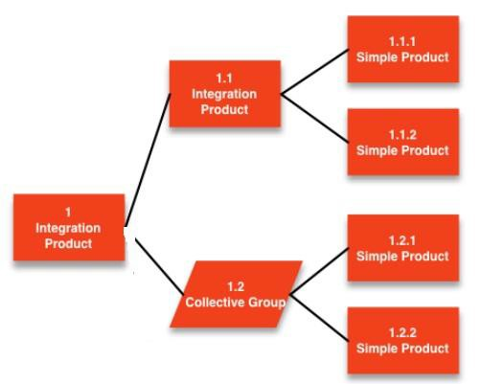
Plan – Product Based Planning Technique
Create Product Flow Diagram

Slide 32
Plan – Roles and Responsibilites
Corporate Programme management set project tolerances and are responsible for approving Exception plan when project-level tolerance are forecast to be exceeded.
Executive approves the project plan and defines tolerance for each stage and approve the stage plan. Approves the Exception plan when stage –level tolerance are forecast to be exceeded. Commit business resources to the stage plan
Senior User ensures that project plan and stage plans remain consistent from the user perspective and commit user resources to stage plans
Senior Supplier ensures that project plan and stage plans remain consistent from the supplier perspective and commit supplier resources to stage plans

Slide 33
Plan – Roles and Responsibilities
Project Manager prepares the project plan and stage plans and decides how the management and technical stages are to be applied. Defines the work package level tolerance and instruct corrective action when the work package level tolerance are forecast to exceed.
Team Manager prepares the team plans and prepares schedules for each work package
Project Assurance monitors changes to the project plan to see
whether there is any impact on the project business case.
Project Support assists with the compilation and the distribution of plans

